Slide 1
Fundamentals of Electric Transmission System Planning Short Course Automating the Planning Process
Scott Dahman
PowerWorld Corporation
scott@powerworld.com
March 19-21, 2024
© copyright Jose Conto, 2024
© copyright Scott Dahman, 2024

Slide 2
Automate or Not to Automate…
If a process would repeat at least twice,
automate it!
José Conto
Notes:
“…everything that happens twice will surely happen a third time“
”

Slide 3
Automate or Not to Automate…
Automate the mundane for quality assurance.
Scott Dahman
Notes:
“…everything that happens twice will surely happen a third time“
”

Slide 4
Automating The Planning Process
A Planning Process is developed within the framework of previous processes, with expert staff and sufficient access to data and modern tools and practices to achieve planning goals and selected data output.
Whole process may not be fit for automation, but most time-consuming sub-processes must be identified and automated
A well-designed automated process:
Minimizes human error along the process
Repetitiveness of the process. It facilitates sensitivity assessment
Reduce time of processing
Maximize usage of computing resources

Slide 5
Automating The Planning Process
A Planning Process can be sub-divided into: The data input process The study process The reporting process | Assessing the reliability of a power system Base cases, contingencies, TPL criteria Perform contingency analysis List buses with voltage violations and lines with overloaded flows

Slide 6
Data Input Process
Gathering of all information and data needed to execute the process. Multiple data format are identified.
Process goals are used to select study methodology and selecting data for input and output
Investigate if data can be retrieved using an automated method (i.e.: via computer downloads)
Identify inter-dependency of data over a timeline. Is all data available at the same time?

Slide 7
Study Process
Methods and tools to execute the process
The method to achieve process’ goals is identify based on available know-how and tools
New study process may require third-party experts
Data format compatible with tool version. Update format/data as needed
Explore newer capabilities of tool/computing engine

Slide 8
Reporting Process
Data output set require to explain the process outcome
Outside context needed to explain the outcome of the study, identify data suitable for a list or a table format
As needed, bring additional data for reporting not used during the study process
Select meaningful data for export to data files or plots

Slide 9
Serial and Script Processing
A serial process executes the tasks of a process in sequence. High speed CPU for faster results.
A basic form of automation: macros or scripts to mimic the sequential steps. User can run the macros from the GUI. For a second macro, the User repeats the steps to run it.
Scripts have a very basic ‘language’, not a programming tool.
Notes:
Traditional tool usage in power system is GUI based, where a sequence of activities are executed to achieve a goal
Ideas of serial processes: line to buy lotto ticket

Slide 10
Planning Processes in Series
Scenario
Scenario
Apply Contingency
Apply Event
Load Flow
Load Flow + Reports
run.py
Reports
Y
More Events?
done
N
Y
More Scenarios?
N
done
10

Slide 11
Planning Processes in Parallel
Study data
Jobs manager
CPU 1
CPU 2
CPU n
Scenario
Scenario
Scenario
Apply Contingency i+1
Apply Contingency i+2
Apply Contingency i+n
…
Load Flow
Load Flow
Load Flow
Reports
Reports
Reports
done
done
done

Slide 12
Automation Tools
PowerWorld Simulator
Batch files and scripting language (auxiliary *.aux file format)
SimAuto Automation Server: handles Simulator as a Microsoft COM object, controllable from any platform that supports external type libraries (Python, VBA, .NET, C++, etc.)
Python-oriented course: https://www.powerworld.com/training/online-training/automation-with-python
Distributed Computing: allows some processes to be done in parallel across CPUs or across cores of an individual CPU
Siemens PSS/E
Idv files allow simple changes to be implemented
Iplan programs allow sequential, multi-run to be scheduled
PyPSSE and Python scripts allow full code control and external libraries

Slide 13
Basic Automation: Scripts or Batch Processes
Scripting language is available in major planning software
PowerWorld Simulator: auxiliary (aux) files
Siemens PSS/E: idv
GE PSLF: EPCL
Scripting Capabilities
Quality Assurance: Standardize settings and controls for multiple cases and studies
Customize user environment (visible fields, field layout, colors, etc.)
Document
Describe an analysis procedure for a manager or client
Create a detailed project record
Enable reproducibility
Automate detailed calculations and storage of the results
Automate building and editing of a one-line diagram

Slide 14
Standardize Settings
Scripts (aux, idv, epcl) may be used to standardize
Solution Options
Limit Monitoring
Contingency Options
Default Drawing Values for One-lines
ATC, OPF, PVQV Options
Many more

Slide 15
Standardize Settings: Example (PW Simulator)
Open ACTIVSg10kOPF.raw
Load aux2000Master.aux to
Set power flow solution options
Set Limit Monitoring
Set Optimal Power Flow (OPF) options
Load generator information
Set AGC to NO for all Hydro, Wind, Solar, and Unknown units
Designate Natural Gas units as OPF Fast Start
Master file calls a series of files with names aux20?0*.aux

Slide 16
Master File
SCRIPT
{
// Custom filters and expressions (used in AGC actions below)
LoadAux("aux2010FiltersExpressions.aux", Yes);
// Power Flow Solution Options
LoadAux("aux2020SolutionOptions.aux", Yes);
// Limit Monitoring Settings
LoadAux("aux2030LimitMonitoring.aux", Yes);
// OPF Options
LoadAux("aux2040OPFOptions.aux", Yes);
// Contingency options and files
// LoadAux("aux2050Contingencies.aux", Yes); // COMMENT out if not needed for this project
// Generator Cost Files
LoadAux("aux2060GeneratorCostModels.aux", Yes);
// Generator AGC Settings
LoadAux("aux2070GeneratorAGC.aux", Yes);
}

Slide 17
Standardize Settings: Tips (PW Simulator)
Use a master file to call secondary files (LoadAux)
Overall procedure can be maintained in the master file
Parameters subject to change over time (e.g. generator cost models) can be stored in the secondary files
Can suppress confirmation dialogs when creating new objects
Use script actions to select all, change selected, then unselect all
Objects that need to be handled specially (e.g. study areas) can be identified by primary key or filter in specific statements
Improves compatibility with different cases having different objects and topology
“Selected” field
Available for every object
Value is not saved with the case and always set to NO when a case is opened

Slide 18
Standardize Settings: Tips (PW Simulator)
Build files by saving case info displays and settings to auxiliary files
Use text editor to review, make changes, and add comments
Can append new DATA sections to existing auxiliary files
Add SCRIPT sections where appropriate
Most Options dialogs in Simulator have a button for Saving to Aux
DATA sections: save only key fields and the records and columns necessary to make needed changes
Example: if setting generator AGC status is the objective, do not include other fields such as Gen MW, Gen Max MW, etc.
Extra fields may be specific to one case and not appropriate for other cases
Use comments to document

Slide 19
Visual Basic Example: Hourly Market Simulation
Microsoft Access-based sample application (VBA)
Download at https://www.powerworld.com/knowledge-base/example-simauto-files
Solves Optimal Power Flow (OPF) for one or more study scenarios
Inputs
Case file
Master settings auxiliary file
Hourly schedules
Loads by area
Fixed (non-AGCable) generation (e.g. wind, solar farms)
Auxiliary files with other time-dependent settings (e.g. generator bids)
Fixed bid ($/MWh) for hydro units (optional)
Hourly Results: retrieved for generators that match user-specified filter
MW dispatch
LMP at terminal bus

Slide 20
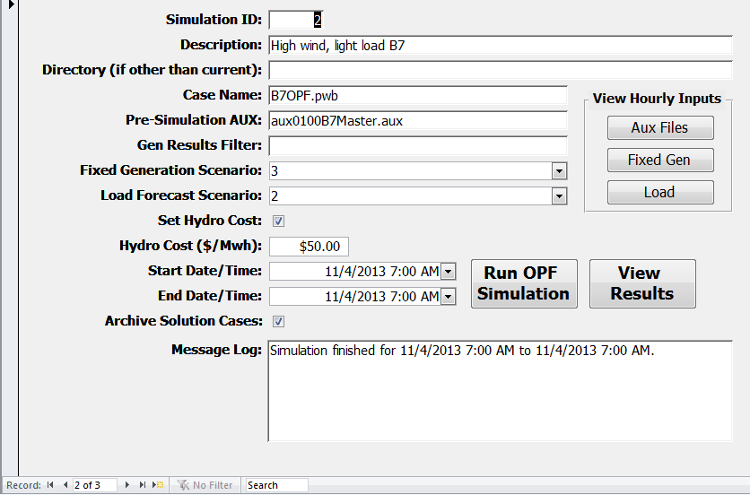
User Interface
Supports multiple studies
Input file details
Generation and Load inputs
Start and end times
Optionally save case file for each solution
Status updates in the Message Log

Slide 21
Hourly Inputs: Area Load
Table tblHourlyInputsAreaLoadForecast
Click “Load” button in the “View Hourly Inputs” group to view
ScenLoadID field corresponds to the selected Load Forecast Scenario on the main form
Forecast Date/Time and AreaNum are additional key fields
Load field contains corresponding area load in MW (application will scale load Mvar to keep power factor constant)

Slide 22
Hourly Inputs: Fixed Generation
Intended for wind and solar
Assumed to follow a historic weather pattern (“fixed” for any given time point)
Assumed price takers
Table tblHourlyInputsFixedGeneration
Click “Fixed Gen” button in the “View Hourly Inputs” group to view
ScenGenID field corresponds to the selected Fixed Generation Scenario on the main form
Forecast Date/Time, BusNum, and GenID are additional key fields
GenMW field contains corresponding generator output in MW

Slide 23
Hourly Inputs: Other Parameters
Additional parameters that change with time may be stored in auxiliary files
These examples contain generator bids for AGCable generation
Click “Aux Files” button in the “View Hourly Inputs” group to view
SimID field corresponds to the current Simulation ID
AuxFileName and EffectiveDate are additional key fields
When the simulation period matches or crosses each EffectiveDate during the simulation, the corresponding file will be loaded

Slide 24
Optional Constant Hydro Price
If “Set Hydro Price” is checked, then the bids for all hydro units will be set to “Hydro Cost ($/Mwh)” for all simulation periods
This cost could be set to a value that results in a desired hydro energy dispatch over the course of the simulation
Bids for all generators (including hydro) could also be specified in case file, the “Pre-Simulation AUX File,” or in any of the time-dependent auxiliary files

Slide 25
“Run OPF Simulation” Process: Initialization
Initialize SimAuto connection
Read hourly generation, load, and auxiliary file lists into arrays
Open Case (SimAuto OpenCase function)
Load Pre-Simulation AUX file (ProcessAuxFile)
Initialize tables for storing results
Load all other auxiliary files with effective dates prior to the Start Date/Time (ProcessAuxFile)

Slide 26
“Run OPF Simulation” Process
For all time points between Start Time and End Time
Load any auxiliary files that have not yet been loaded and with effective dates less than or equal to the Current Time (ProcessAuxFile)
Set fixed generator MW values (ChangeParametersMultipleElement)
If “Set Hydro Price” is checked, set bids for all hydro units to “Hydro Cost ($/Mwh)” (RunScriptCommand)
Set area Loads (scale them with RunScriptCommand “SetData”)
Solve OPF (RunScriptCommand)
If “Archive Solution Cases” is checked, save a pwb file (SaveCase)
Retrieve Results: generator dispatch and LMPs (GetParametersMultipleElement) that match optional filter
Next Time Point

Slide 27
Load Auxiliary Files Associated with Prior Time
Private Sub LoadScenarioAuxFilesUpToStartTime()
Dim AuxName As String
'if there are unprocessed files in the aux file list
If AuxFileVectorIndex < AuxFileVectorCount Then
Do While AuxFileVector(AuxFileVectorIndex, 0) < StartTime
AuxName = pwPathName + "\" + AuxFileVector(AuxFileVectorIndex, 1)
'append .aux if the file name does not include it
If Len(AuxName) > 0 And LCase(Right(AuxName, 4)) <> ".aux" Then _
AuxName = AuxName + ".aux"
'load the next aux file
MySimAuto.ProcessAuxFile (AuxName)
'increment pointer
AuxFileVectorIndex = AuxFileVectorIndex + 1
'if we have reached the end of the file, then quit (exit loop)
If AuxFileVectorIndex = AuxFileVectorCount Then Exit Do
Loop
End If
End Sub

Slide 28
Fixed Generator MW Output (Wind and Solar)
ParamList = Array("BusNum", "GenID", "GenMW", "GenAGCAble")
.
Do While GenMWVector(GenMWVectorIndex, 0) = DateTimeLocal
Dim IndValueList(3) As Variant
IndValueList(0) = GenMWVector(GenMWVectorIndex, 1) 'BusNum
IndValueList(1) = GenMWVector(GenMWVectorIndex, 2) 'GenID
IndValueList(2) = GenMWVector(GenMWVectorIndex, 3) 'GenMW
IndValueList(3) = "NO" 'GenAGCAble
.
'set the next record in ValueList to match those just read from GenMWVector
ValueList(UBound(ValueList)) = IndValueList
'increment pointer
GenMWVectorIndex = GenMWVectorIndex + 1
.
Loop
' send geneartor MW values into Simulator
Output = MySimAuto.ChangeParametersMultipleElement("Gen", ParamList, ValueList)

Slide 29
Scale Load by Area
'scale values for area load that meet the next time point
Do While pwLoadVector(LoadVectorIndex, 0) = DateTimeLocal
AreaNumString = CStr(pwLoadVector(LoadVectorIndex, 1))
ScaleMWString = CStr(pwLoadVector(LoadVectorIndex, 2))
'do the scaling for the next area
pwScriptCommand = "SetData(AREA,[AreaNum,BGScale],[" & AreaNumString & ",YES]);" _
+ "Scale(LOAD,MW,[" & ScaleMWString & "],AREA);" _
+ "SetData(AREA,[AreaNum,BGScale],[" & AreaNumString & ",NO]);"
MySimAuto.RunScriptCommand(pwScriptCommand)
'increment pointer
LoadVectorIndex = LoadVectorIndex + 1
.
Loop

Slide 30
Solve OPF and Retrieve Results
'solve power flow and OPF
pwScriptCommand = "EnterMode(POWERFLOW); SolvePowerFlow; SolvePrimalLP;"
Output = MySimAuto.RunScriptCommand(pwScriptCommand)
If Output(0) = "" Then
SolvePWOPF = True
.
Else
SolvePWOPF = False
End If
.
ObjType = "GEN"
FieldArray = Array("BusNum", "GenID", "GenMW", "BusMCMW")
'retrieve Generator MW and bus LMP from Simulator
GenRecords = MySimAuto.GetParametersMultipleElement(ObjType, FieldArray, pwGenFilt)

Slide 31
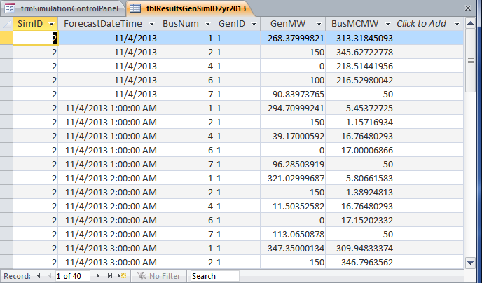
View Results
Click “View Results” to see table of hourly generator dispatch and generator bus LMPs

Slide 32
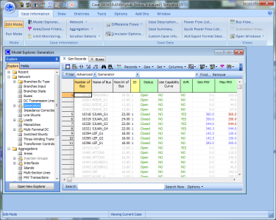
Distributed Computing (PW Simulator)
Communication over DCOM
SimAuto
Process 1
Master Simulator Process
SimAuto
Process 2
…
SimAuto
Process n

Slide 33
Distributed Computing Implementation
Create a pool of SimAuto instances.
Send current case to each SimAuto in the pool.
Send current tool’s settings to each SimAuto.
Break the calculation into small chunks (groups of contingencies, individual ATC scenarios, etc.).
Distribute chunks to each available SimAuto in the pool until there are no more chunks left.
After a chunk is completed, gather the results into a list.
Release the SimAuto instance back into the pool of available SimAutos
Take the results list and apply it to the current case

Slide 34
Distributable Calculations
Easily identifiable cleaving points (sub-problem can be separated and solved independently)
An individual contingency (steady state and transient stability)
An Available Transfer Capability (ATC) scenario
A QV-curve solution at a Bus
Independence of individual operations
SimAutos within pool do not communicate with each other
Too much network communication causes large overhead

Slide 35
Questions?

